Slide 1
CHAPTER - 1
MECHANISM AND MACHINES

Slide 2
INTRODUCTION
THEORY OF MACHINE:
The theory of machine and mechanism is an applied science which is used to understand the relative motion between the geometry and motion of the parts of a machine or the mechanism and the study of the forces which produce these motions.
Theory of Machine
Dynamics
Statics
Kinetics
kinematics

Slide 3
Kinematics:
The study of motion for mechanisms without consideration of the forces and stresses produced is called kinematics.

Slide 4
Dynamics
It relates to study of forces acting on various parts of a machine.
(a) Statics:
It deals with the forces which act on parts of a machine which assumed without mass.
(b) Kinetics:
It deals with the inertia forces due to combined effect of mass and motion of the parts.

Slide 5
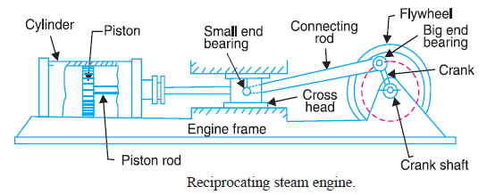

Slide 6
Kinematic link
Each part of machine which has relative motion to some other part of the machine is known as kinematic link or an element.
Link may consist of number of parts connected in such a way that they have no relative motion between them.
It is a resistant body
Resistant bodies are those which are rigid for the purposes they have to serve. i.e. belt drive
links
Rigid link
i.e piston,connecting rod, crank etc
Flexible link
i.e chains, belt, springs etc
Fluid link
i.e liquid used hydraulic press,jacks ect

Slide 7
Machine and structure
Structure
No relative motion between its links.
Serves to modify and transmit the forces
Cannot transmit the energy
Example – roof trusses
Machine
Relative motion between the links.
Serves to transfer both forces and motion
Transforms the available energy
Example – screw jack, IC engine, lathe etc.

Slide 8
Constrained Motion
Constrained motion
Completely constrained motion
Incompletely constrained motion
Successfully constrained motion

Slide 9
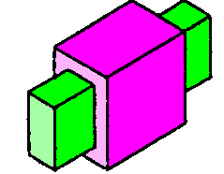
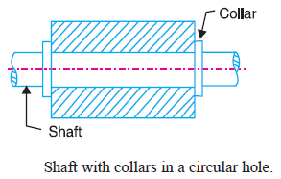
Completely constrained motion
A completely constrained motion is one in which the relative motion between the two links can be place only in a definite direction and it can be predicted

Slide 10
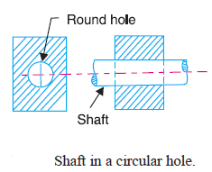
Incompletely constrained motion
An incompletely constrained motion is one in which the relative motion between the two links can be place in more than one direction and it cannot be predicted

Slide 11
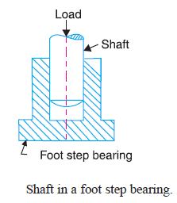
Successfully constrained motion
When the relative motion between the links is not completely constrained by itself but it is made so by some other means is called successfully constrained motion.
Prof. N..J.Patel

Slide 12
Kinematic pair
When two kinematic links are connected in such a way that their motion is either completely or successfully constrained, these two links are said to form a kinematic pair.
Kinematic pair
nature of relative motion
nature of contact
mechanical arrangement

Slide 13
According to nature of relative motion between the link
Sliding pair or prismatic pair
Turning or revolute pair
Screw or helical pair
Rolling pair.
Spherical or globular pair

Slide 14
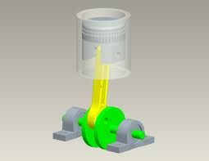
Sliding pair or prismatic pair
one link is constrained to have a sliding motion relative to other link.
Example : piston and cylinder, ram and its guide in shaper, tail stock on lathe bed etc.

Slide 15
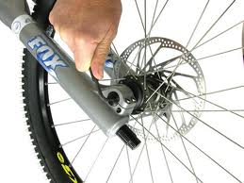
Turning or revolute pair
One link is constrained to turn or revolute relative to the other link.
Example : wheel turning over the axle, crank shaft rotating in its bearings, lathe spindle supported in head stock etc.

Slide 16
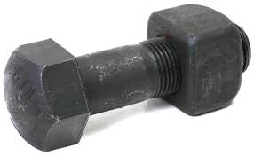
Screw or helical pair
One element can turn about the other by screw threads.
Example : the motion of bolt in fixed nut, the lead screw of lathe with nut etc.

Slide 17
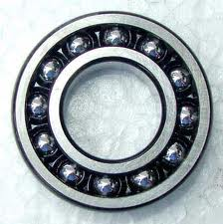
Rolling pair.
One of the links rolls over the other link
Example : ball with its bearing, the ball and shaft

Slide 18
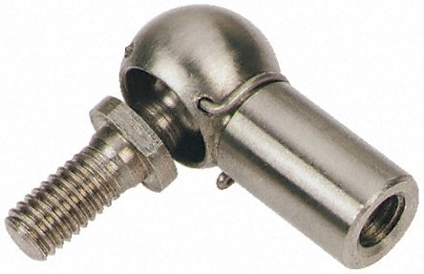

Spherical or globular pair
One element with spherical shape turns or swivels with the other fixed elements.
Example : a ball and socket joint.

Slide 19
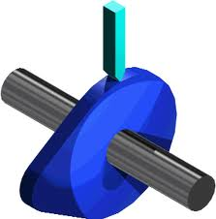
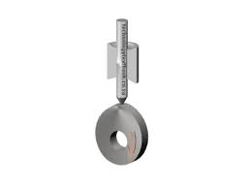
According to types of contact between the links.
Surface or area contact
One elements slides over the surface of other.
Sliding pair, screw pair and turning pair form the lower pair
Line or point contact
Motion is partly turning and partly sliding.
Friction discs, cam and follower, toothed gearing, ball and roller bearing etc
Lower pair
Higher pair

Slide 20
According of the mechanical arrangement
Closed pair or self closed pair
when the two elements of a pair are connected together mechanically in such a way that only required kind of motion occurs.
Example: all lower pairs
Forced closed pair or unclosed pairs or open pairs
when the two elements of a pair are not connected mechanically but kept in contact by the action of external forces.
Example: Cam and follower

Slide 21
Kinematic chain
Kinematic chain is defined as the combination of kinematic pairs in which each link forms a part of two kinematic pairs and the relative motion between the links is either completely constrained or successfully constrained.
Example: the crank shaft of an engine forms a kinematic pair with bearings which are fixed in a pair.
the connecting rod with a crank.
Piston with the connecting rod.
Piston with the cylinder.
The relation between no. of pairs(p) forming the kinematic chain and links(l)
l = 2p-4…...(i)
J = (3/2)l – 2…...(ii)
For higher pair, one higher pair is equivalent to two lower pair.

Slide 22
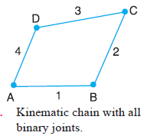
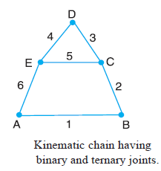
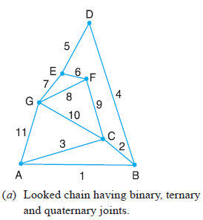
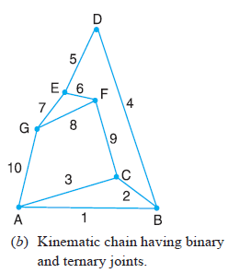
Types of joints in a chain
Binary joint ternary joint

Slide 23
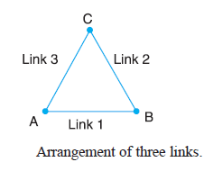
Case - 1
l = 3
p = 3
j = 3
From eq. 1
l = 2p – 4
3= 2x3 – 4 = 2
L.H.S. > R.H.S.
From eq. 2
L.H.S. > R.H.S.
So it is locked chain.

Slide 24
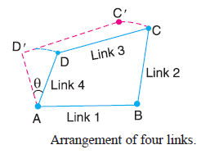
Case - 2
l = 4
p = 4
j = 4
From eq. 1
l = 2p – 4
4= 2x4 – 4 = 4
L.H.S. = R.H.S.
From eq. 2
L.H.S. = R.H.S.
So it is kinematic chain.

Slide 25
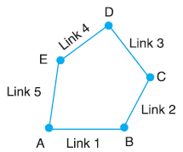
Case - 3
l = 5
p = 5
j = 5
From eq. 1
l = 2p – 4
5= 2x5 – 4 = 6
L.H.S. < R.H.S.
From eq. 2
L.H.S. < R.H.S.
So it is unconstrained chain.

Slide 26
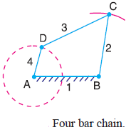
Grashof’s Law
“ for a planer four bar mechanism, the sum of the length of shortest and longest links should not be greater than the sum of the length of two other links if there is to be a continuous relative motion between them.”
l₃+l₄ ≤ l₁+l₂

Slide 27
Mechanism
A mechanism is a kinematic chain with any one link fixed which is used to transmit the required motion.
A mechanism with four links is called a simple mechanism and mechanism with more than four links is called a compound mechanism.
Inversion of mechanism
in case the different links of a kinematic chain are fixed, the result is a different mechanism. Such mechanism obtained are called inversion of mechanism.
when the different links of a kinematic chain are used as a frame, the relative motion of various links are not altered, however, the absolute value of motion of such mechanism is drastically altered.

Slide 28
Types of inversions
Four bar kinematic chain
Coupled wheel of a locomotive
Beam engine
Double slider kinematic chain
Single slider kinematic chain
Watt’s engine indicator

Slide 29
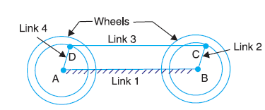
Coupled wheels of a locomotive(double crank)
video
The mechanism of a coupling rod of a locomotive (also known as double crank mechanism) which consists of four links, is shown in Fig.
In this mechanism, the links AD and BC (having equal length) act as cranks and are connected to the respective wheels. The link CD acts as a coupling rod and the link AB is fixed in order to maintain a constant centre to centre distance between them. This mechanism is meant for transmitting rotary motion from one wheel to the other wheel.

Slide 30
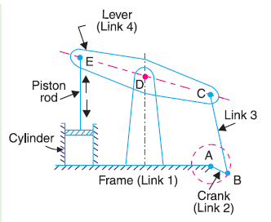
Beam engine(crank and lever mechanism)
A part of the mechanism of a beam engine (also known as crank and lever mechanism) which consists of four links, is shown in Fig.
In this mechanism, when the crank rotates about the fixed centre A, the lever oscillates about a fixed centre D. The end E of the lever CDE is connected to a piston rod which reciprocates due to the rotation of the crank. In other words, the purpose of this mechanism is to convert rotary motion into reciprocating
motion.
video

Slide 31
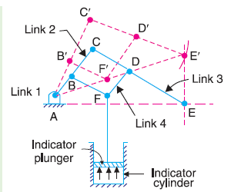
Watt’s engine indicator
Watt’s indicator mechanism (also known as Watt's straight line mechanism) which consists of four links, is shown in Fig.
The four links are : fixed link at A, link AC, link CE and link BFD. It may be noted that
BF and FD form one link because these two parts have no relative motion between them. The links CE and BFD act as levers. The displacement of the link BFD is directly
proportional to the pressure of gas or steam which acts on the indicator plunger. On any small displacement of the mechanism, the tracing point E at the end of the link CE
traces out approximately a straight line.
The initial position of the mechanism is shown in Fig. by full lines whereas the dotted lines show the position of the mechanism when the gas or steam pressure acts on the indicator plunger.

Slide 32
Single slider kinematic chain
Reciprocating engine mechanism
Crank and slotted lever quick return mechanism
Gnome engine or rotary engine
Withworth quick return mechanism
Oscillating cylinder engine
Hand pump

Slide 33
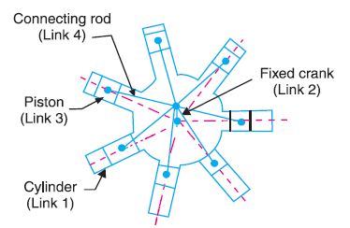
Gnome engine or rotary engine
Video
Sometimes back, rotary internal combustion engines were used in aviation.
But now-a-days gas turbines are used in its place.
It consists of seven cylinders in one plane and all revolves about fixed centre D, as shown in Fig. while the crank (link 2) is fixed. In this mechanism, when the connecting rod (link 4) rotates, the piston (link 3) reciprocates inside the cylinders forming link 1.

Slide 34
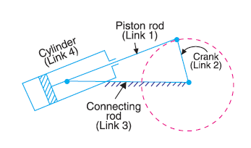
Oscillating cylinder engine
video
The arrangement of oscillating cylinder engine mechanism, as shown in Fig. is used to convert reciprocating motion into rotary motion. In this mechanism, the link 3 forming the turning pair is fixed. The link 3 corresponds to the connecting rod of a reciprocating steam engine mechanism.
When the crank (link 2) rotates, the piston attached to piston rod (link 1) reciprocates and the cylinder (link 4) oscillates about a pin pivoted to the fixed link at A.

Slide 35
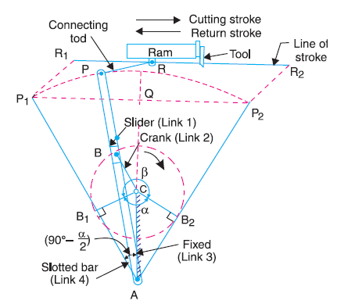
Crank and slotted lever type quick return mechanism
video

Slide 36
This mechanism is mostly used in shaping machines, slotting machines and in rotary internal combustion engines.
In this mechanism, the link AC (i.e. link 3) forming the turning pair is fixed, as shown in Fig.
The link 3 corresponds to the connecting rod of a reciprocating steam engine.
The driving crank CB revolves with uniform angular speed about the fixed centre C.
A sliding block attached to the crank pin at B slides along the slotted bar AP and thus causes AP to oscillate about the pivoted point A.
A short link PR transmits the motion from AP to the ram which carries the tool and reciprocates along the line of stroke R1R2. The line of stroke of the ram (i.e. R1R2) is perpendicular to AC produced.

Slide 37
In the extreme positions, AP1 and AP2 are tangential to the circle and the cutting tool is at the end of the stroke. The forward or cutting stroke occurs when the crank rotates from the position CB1 to CB2 (or through an angle β) in the clockwise direction. The return stroke occurs when the crank rotates from the position CB2 to CB1 (or through angle α) in the clockwise direction. Since the crank has uniform angular speed, therefore,

Slide 38
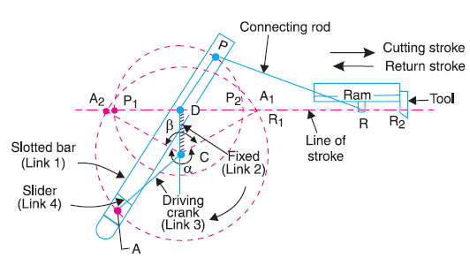
Withworth quick return mechanism
video

Slide 39
This mechanism is mostly used in shaping and slotting machines. In this mechanism, the link CD (link 2) forming the turning pair is fixed, as shown in Fig. The link 2 corresponds to a crank in a reciprocating steam engine. The driving crank CA (link 3) rotates at a uniform angular speed. The slider (link 4) attached to the crank pin at A slides along the slotted bar PA (link 1) which oscillates at a pivoted point D. The connecting rod PR carries the ram at R to which a cutting tool is fixed. The motion of the tool is constrained along the line RD produced, i.e. along a line passing through D and perpendicular to CD.

Slide 41
Double slider kinematic chain
Scotch yoke mechanism
Oldham’s coupling
Elliptical trammel

Slide 42
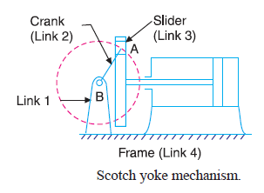
Scotch yoke mechanism
This mechanism is used for converting rotary motion into a reciprocating motion. The inversion is obtained by fixing either the link 1 or link 3. In Fig. link 1 is fixed. In this mechanism, when the link 2 (which corresponds to crank) rotates about B as centre, the link 4 (which corresponds to a frame) reciprocates. The fixed link 1 guides the frame.
video

Slide 43
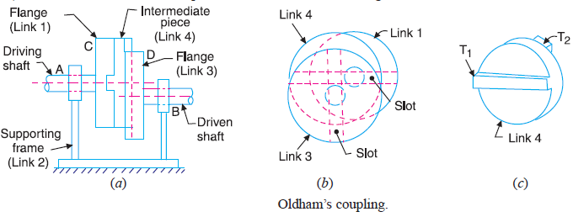
Oldham’s coupling

Slide 44
An oldham's coupling is used for connecting two parallel shafts whose axes are at a small distance apart. The shafts are coupled in such a way that if one shaft rotates, the other shaft also rotates at the same speed. This inversion is obtained by fixing the link 2, as shown in Fig. The shafts to be connected have two flanges (link 1 and link 3) rigidly fastened at their ends by forging.
The link 1 and link 3 form turning pairs with link 2. These flanges have diametrical slots cut in their inner faces, as shown in Fig. The intermediate piece (link 4) which is a circular disc, have two tongues (i.e. diametrical projections) T1 and T2 on each face at right angles to each other, as shown in Fig. The tongues on the link 4 closely fit into the slots in the two flanges (link 1 and link 3). The link 4 can slide or reciprocate in the slots in the flanges.

Slide 45
When the driving shaft A is rotated, the flange C (link 1) causes the intermediate piece (link 4) to rotate at the same angle through which the flange has rotated, and it further rotates the flange D (link 3) at the same angle and thus the shaft B rotates. Hence links 1, 3 and 4 have the same angular velocity at every instant. A little consideration will show, that there is a sliding motion between the link 4 and each of the other links 1 and 3.

Slide 46
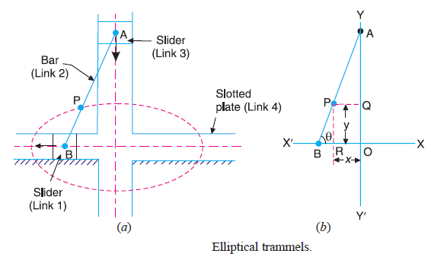
Elliptical trammel

Slide 47
It is an instrument used for drawing ellipses. This inversion is obtained by fixing the slotted plate (link 4), as shown in Fig. The fixed plate or link 4 has two straight grooves cut in it, at right angles to each other. The link 1 and link 3, are known as sliders and form sliding pairs with link 4. The link A B (link 2) is a bar which forms turning pair with links 1 and 3.
When the links 1 and 3 slide along their respective grooves, any point on the link 2 such as P traces out an ellipse on the surface of link 4, as shown in Fig. 5. A little consideration will show that AP and BP are the semi-major axis and semi-minor axis of the ellipse respectively. This can be proved as follows :

Slide 48
